Slide 1
Semantic Segmentation For Self Driving Cars
Here is where your presentation begins

Slide 2
Table of Contents
01
02
03
04
Introduction
Workflow
Results
Conclusion

Slide 3
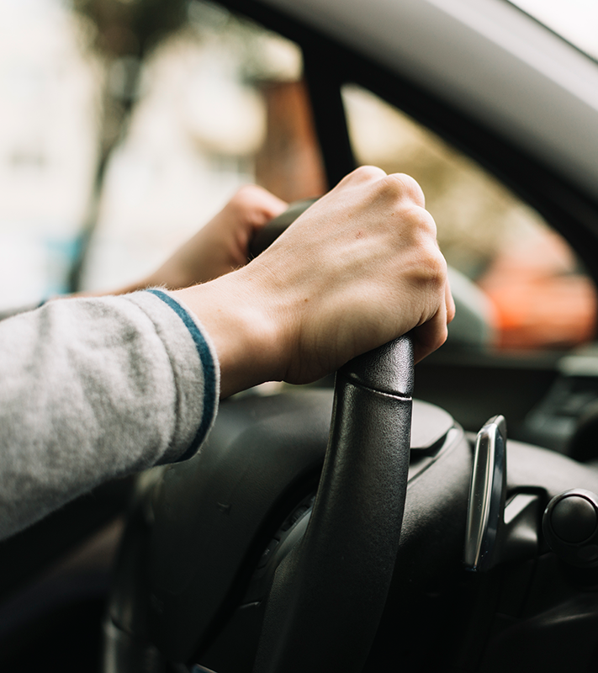
01
Introduction

Slide 4
1
2
3
Problem
Solve
Data

Slide 5


Workflow

Slide 6
Example of Images from Data set

Slide 7
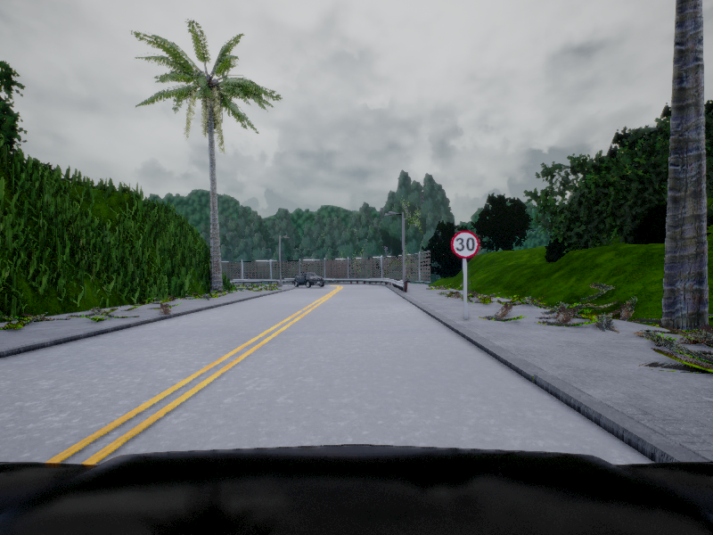
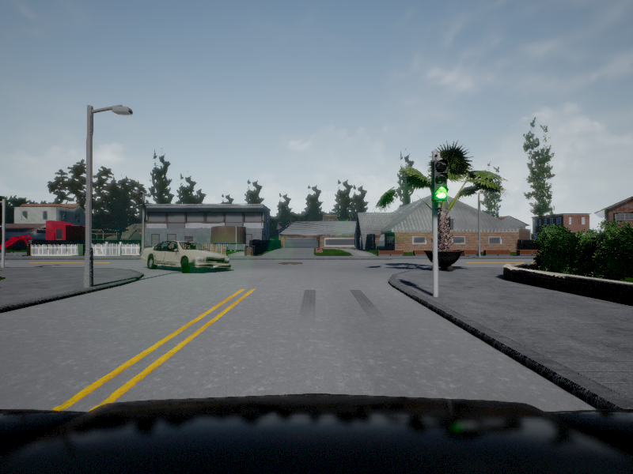
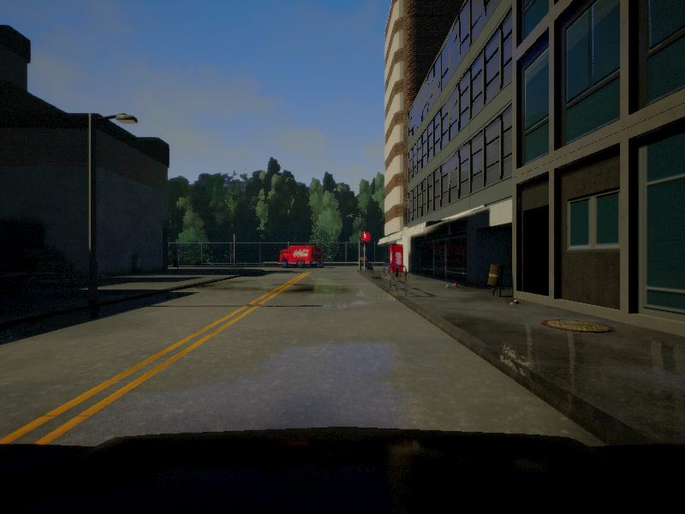
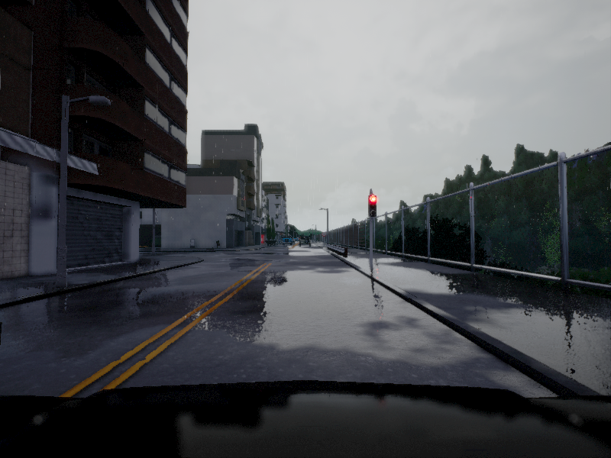
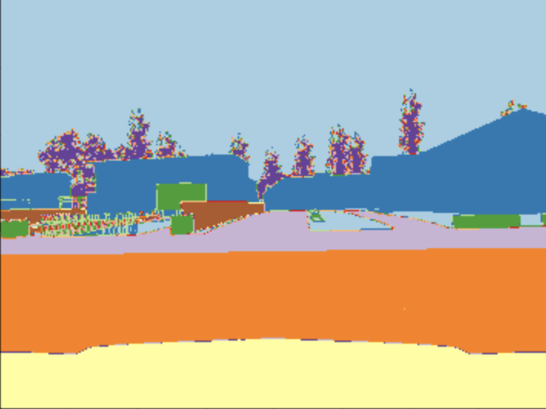
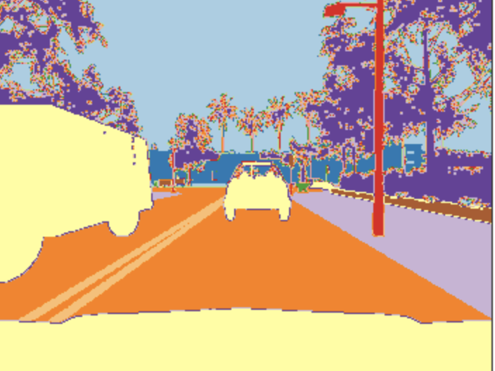
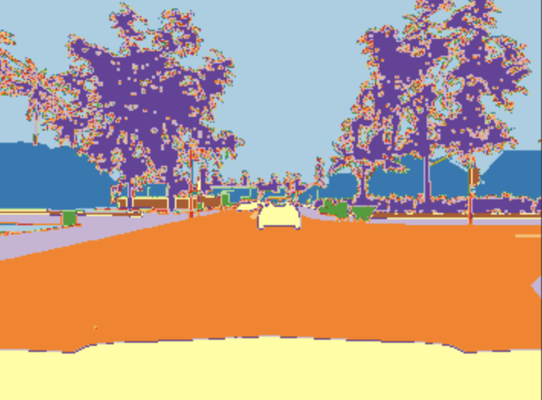

Slide 8
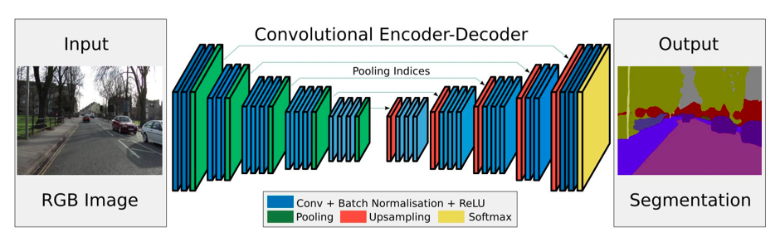
Convolutional Encoder Decoder

Slide 9
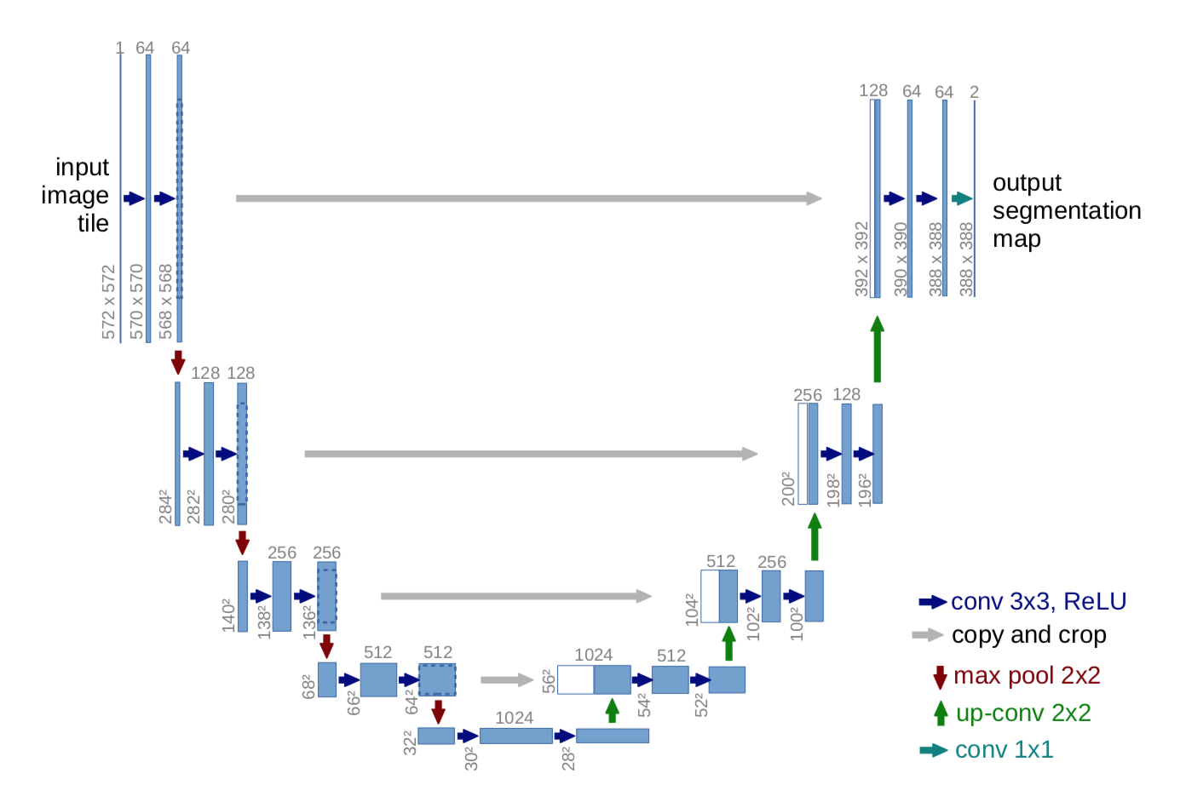
U-net
Arcature

Slide 10
Project Phases

Slide 11


Slide 12
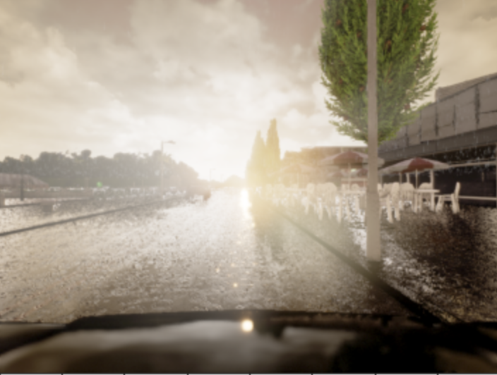


Prediction
Image
Mask(Actual)

Slide 13
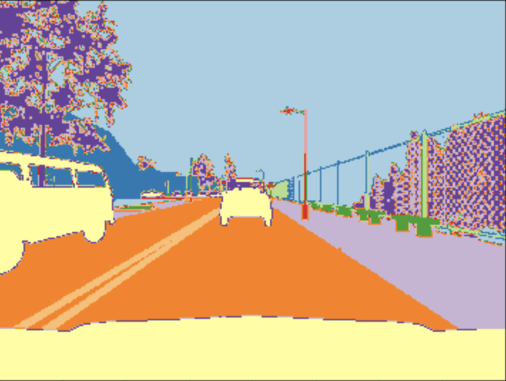
2

Slide 14
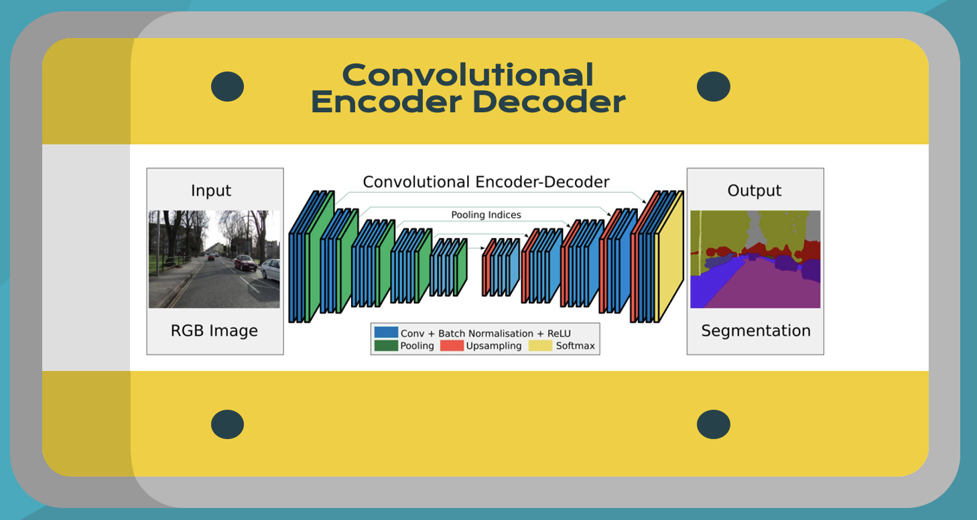
Transfer Learning of Encoder
VGG16
3

Slide 15
Transfer Learning of Encoder and Decoder
MobileNetV2
4

Slide 16
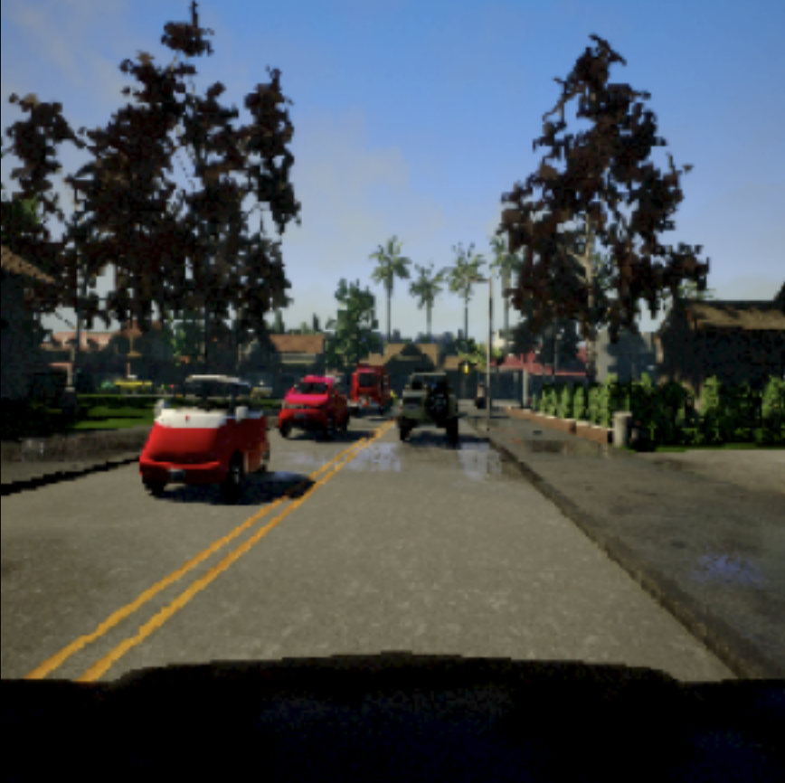
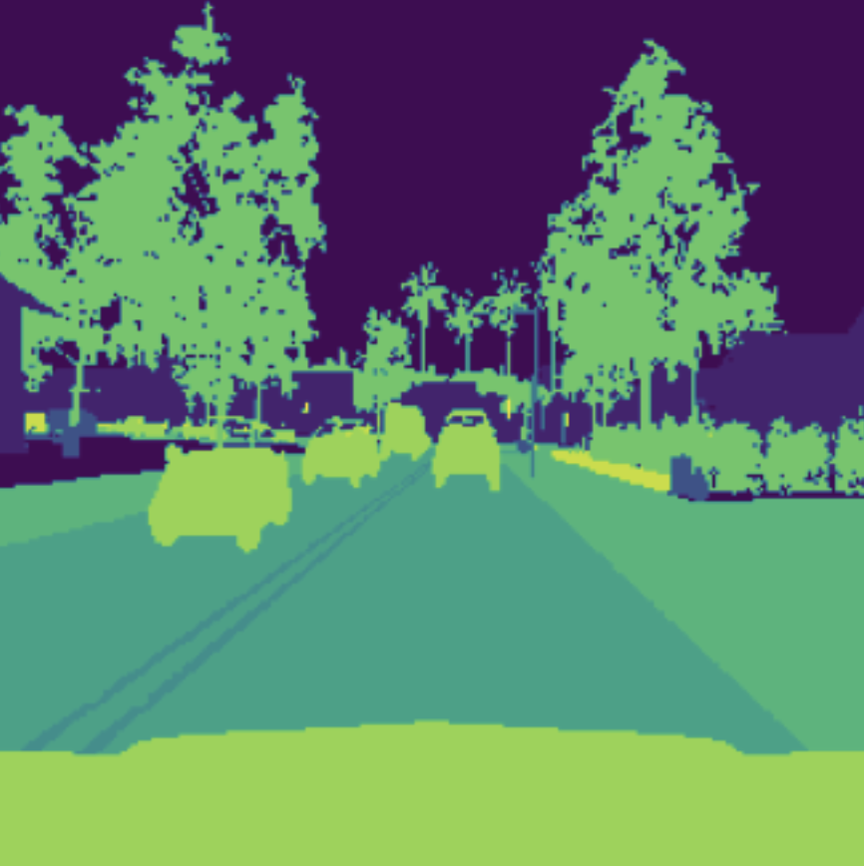
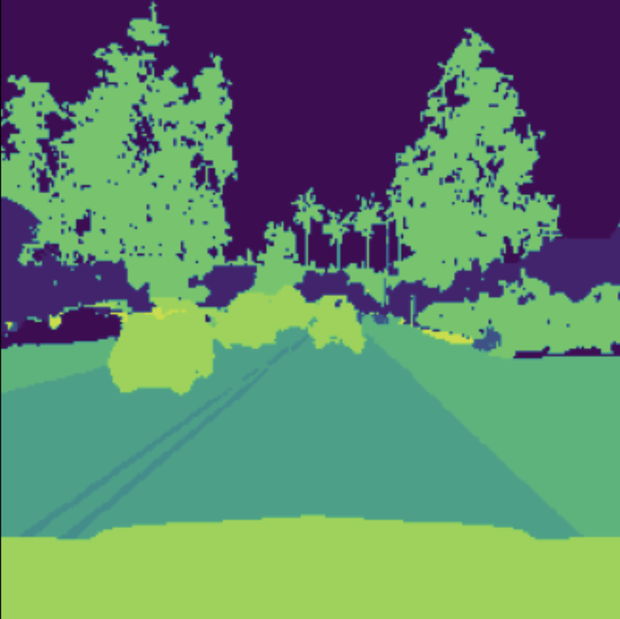
Prediction
Image
Mask(Actual)

Slide 17
03
Results

Slide 18
1
Accuracy
2
IOU

Slide 19

Intersection over Union

Slide 20



Evaluation
Train | 0.68 | 0.69 | 0.69
Validation | 0.68 | 0.69 | 0.68
Test | 0.70 | 0.68 | 0.67

Slide 21
Conclusion

Slide 22

THANKS

